Slide 1
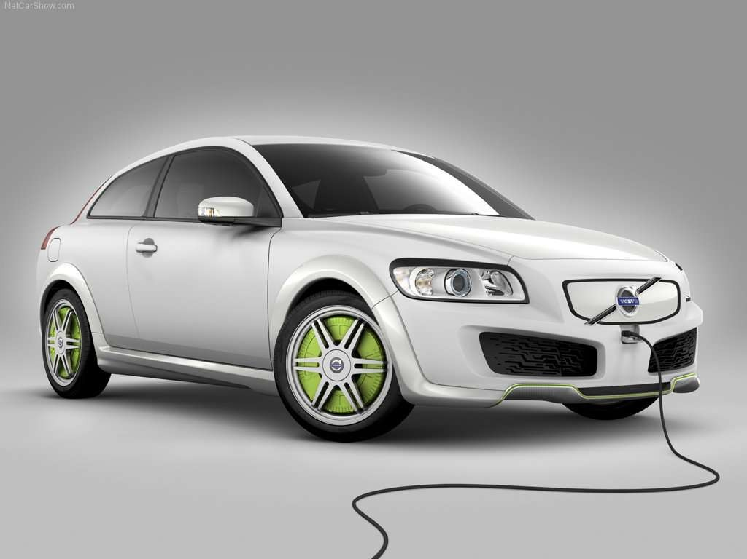


ELECTRIC CARS
Buğra BAYRAMOĞLU David ALP YOLTAY
Koray GENÇ

Slide 2
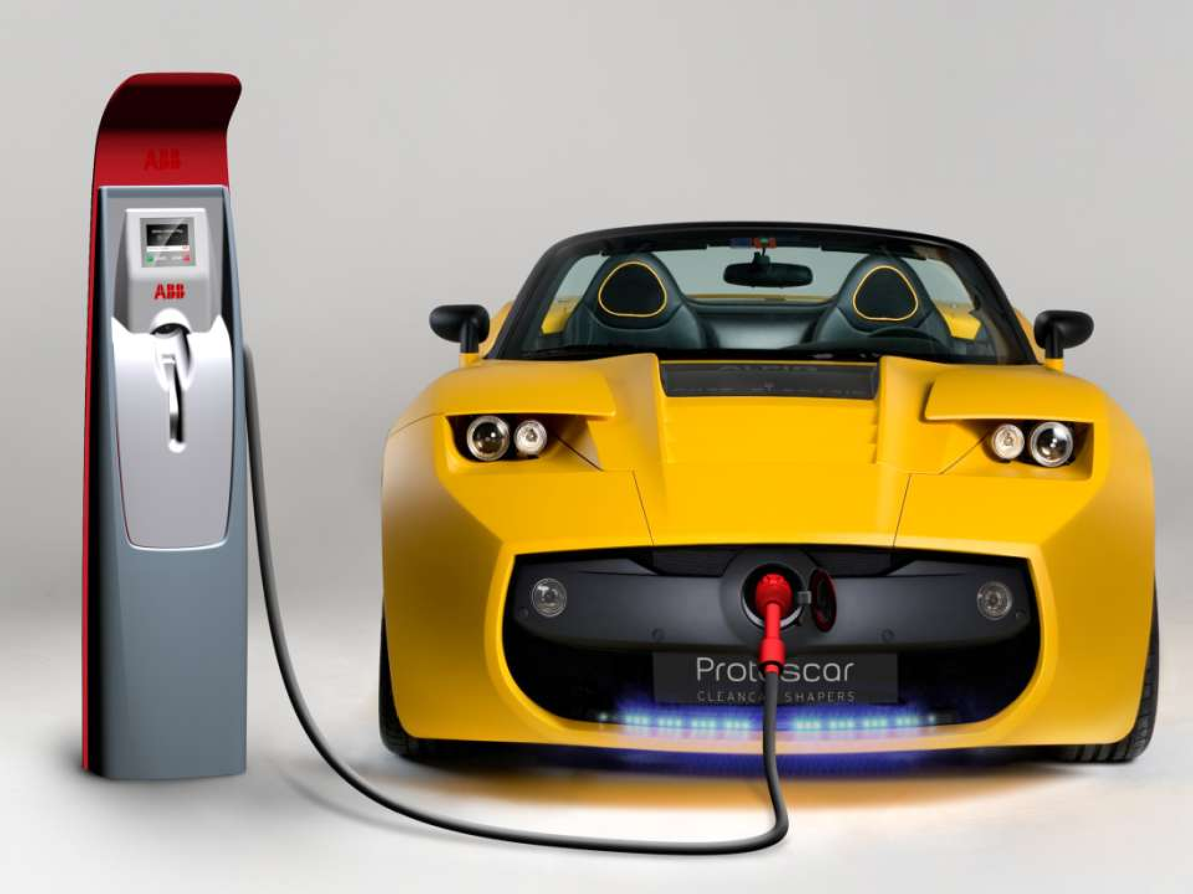
What is an Electric Car?

Slide 3

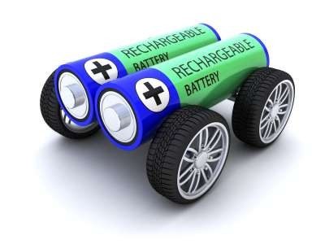
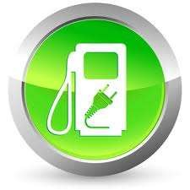
ELECTRIC CARS
What is an electric car?
Propelled by electric motors
Uses electrical energy stored in batteries

Slide 4


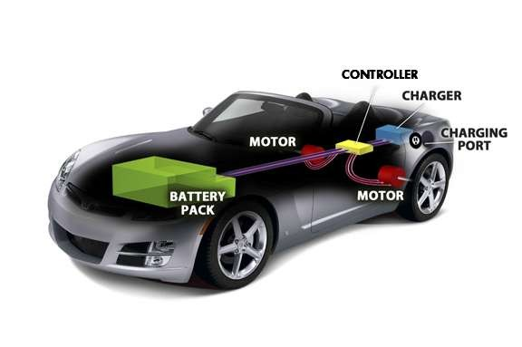
ELECTRIC CARS
How does it work?
Has three main parts;
Electric Motor
Controller
Battery

Slide 5
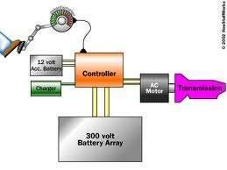
ELECTRIC CARS
How does it work?
When the pedal is pushed;
The controller gathers energy from the battery,
Controller delivers the appropriate amount of electrical energy to the motor.
Electric energy transforms to mechanical energy.
Wheels turn, vehicle moves.

Slide 6
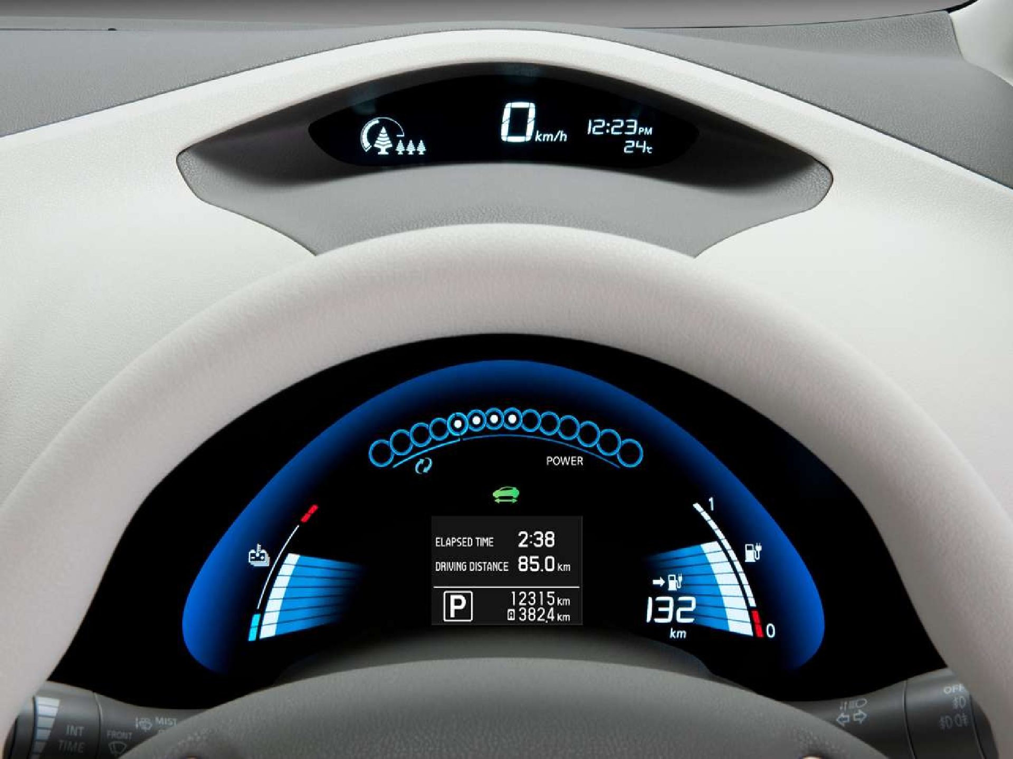

Slide 7


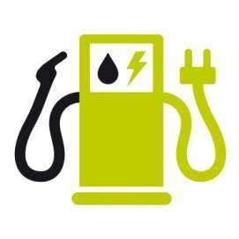
ELECTRIC CARS
Economical Advantages
You can drive up to 70 KM according to the The United States
Department of
Energ icity.
y for a dollar’s worth electr
Even for a low fuel consumption car* in Turkey you can drive about 7 KM max for a dollar’s worth gasoline.
* Hyundai Getz 1.4

Slide 8

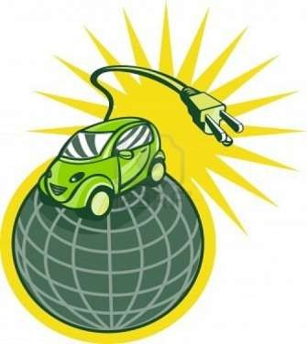
ELECTRIC CARS
Economical Advantages
Rechargeable batteries
have a long useful life.
Low operating costs
Reduced cost of wear and tear during routine maintenance.

Slide 9

ELECTRIC CARS
Economical Advantag
In a documentary by Nissan,
it was estimated that the 5-year operating cost for a standard battery-powered vehicle to be around
$1,800, while the 5-year operating cost of a gasoline car is $6,000.
es

Slide 10

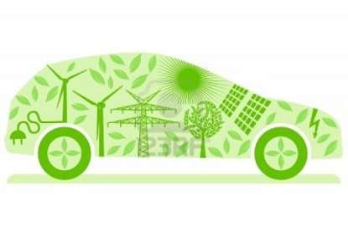
ELECTRIC CARS
Environmental Benefits
Less Carbon Emission – No Air Pollution
No Fire Hazards
Less Noise
Pollution
Recycleable Batteries – No Disposal Problem

Slide 11


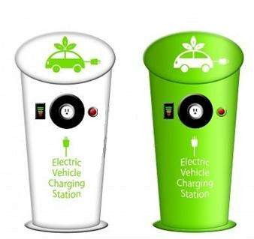
ELECTRIC CARS
Environmental
Benefits
According to the Electric Vehicle Association of Canada, or EVAC, even EVs recharged from coal-powered electric generators cut carbon emission roughly in half.

Slide 12

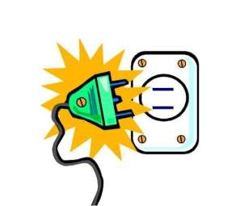
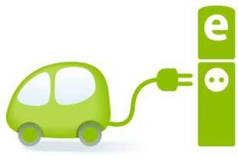
ELECTRIC CARS
Availability Advantage
Electricity is not scarce unlike gasoline
External tools to make it possible to even charge at home

Slide 13




ELECTRIC CARS
Disadvantages
High Recharge Time
Limited Service Facilities
Cost Of Vehicles
Few Models
•
Speed

Slide 14
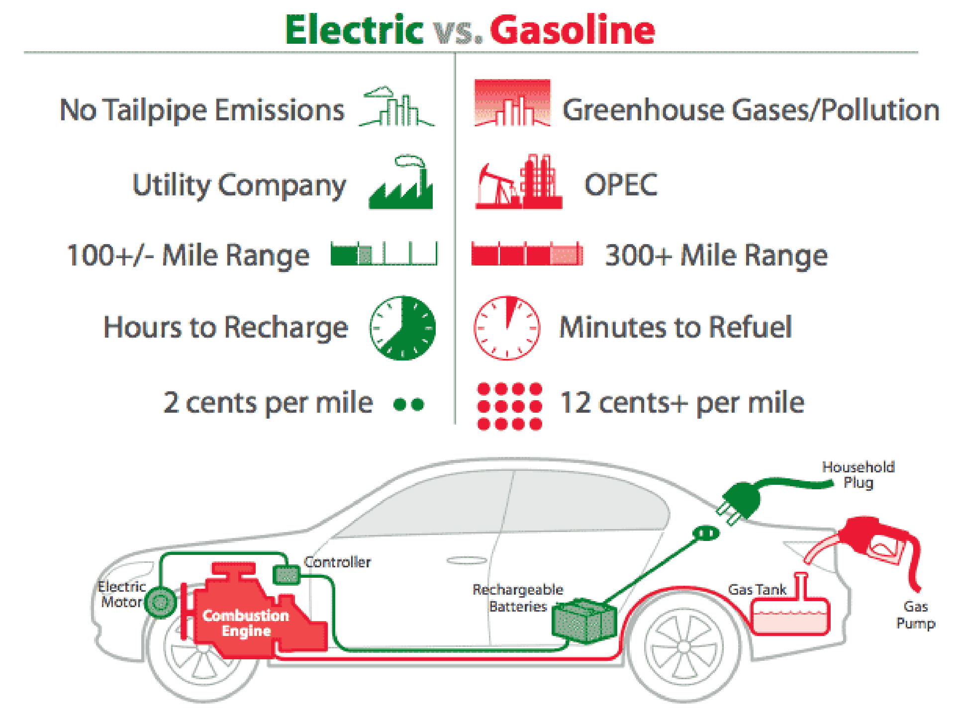

Slide 15
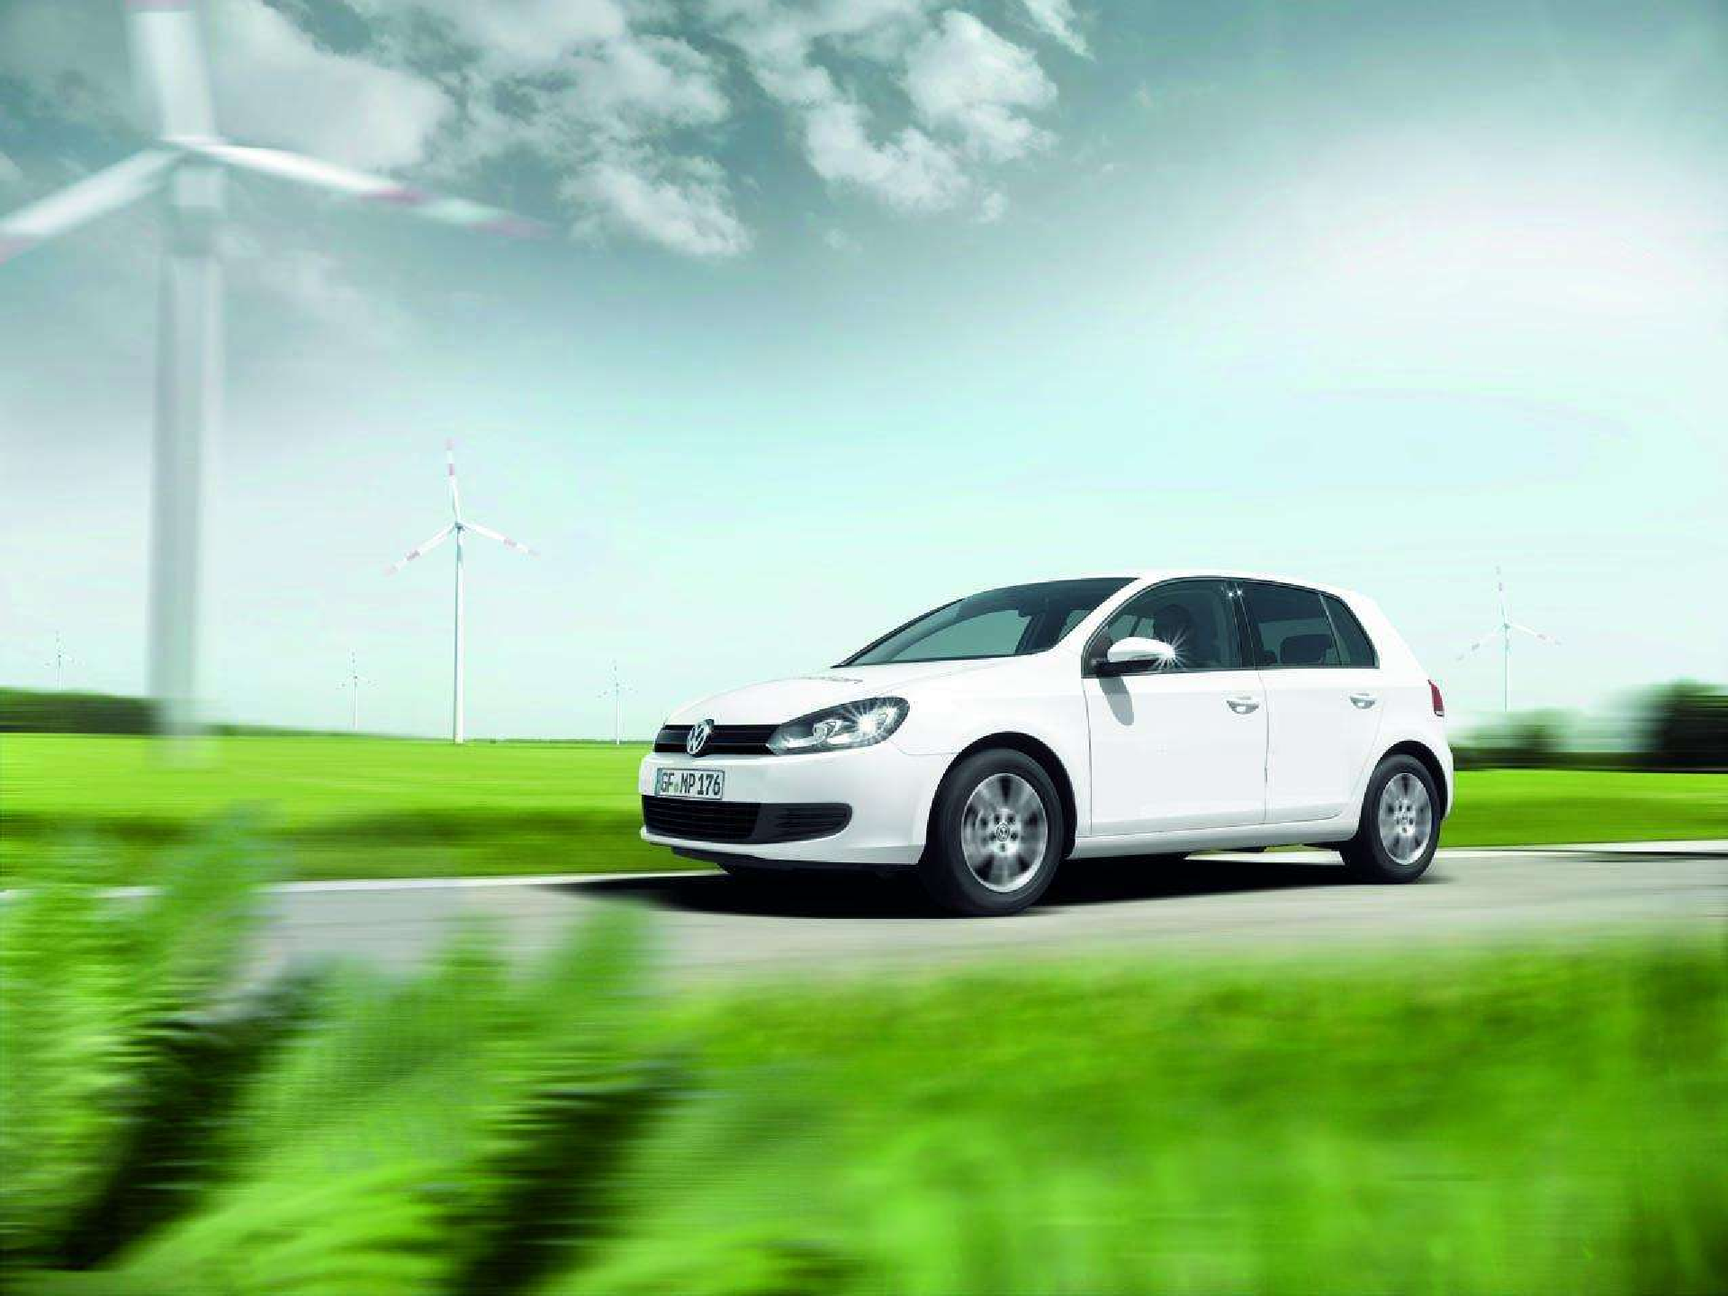
"If this is the future, I'm not that worried." Jay Leno (after driving an electric car)

